Slide 1
Analysis of Google Play Store Data

Slide 2
Overview and problem statement
Which apps are most reviewed? Out of those, which three have the highest ratings?
How do the apps vary by rating, pricing etc.,?
Do people review paid apps in the same way they review free apps?
Notes:
We are framing this problem in terms of a clear business need. And asking the question, what is this analysis actually going to do for our business, right? Remember, it’s our world, the statistics are just living in it!

Slide 3
Data analyzed
Almost 2.9 million applications as of today
Details of 10,000 apps for analysis purposes
Data includes app category, rating, number of installs, price, free vs. paid app etc.,
Notes:
Set the stage a bit -- where is the data coming from? Be as transparent as possible. Explain to the audience what you were thinking about data collection in terms of what data was necessary and how that in turn shaped your thinking on the kind of analysis that would be most appropriate given the objective.

Slide 4
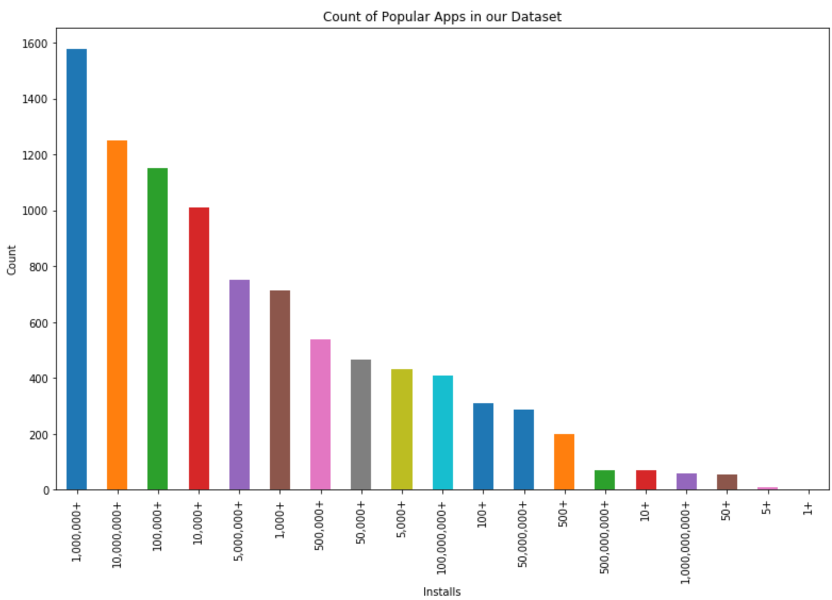
Popular Apps
Notes:
Moving from research question to some kind of hypothesis -- you want to use logic, theory and prior empirical evidence to move toward some hypotheses you can test. This is why domain expertise cannot be overlooked among data scientists.

Slide 5
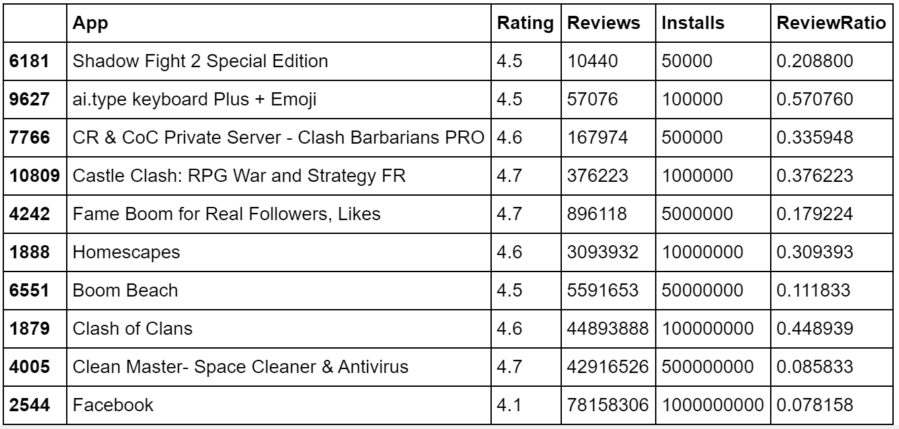
Most Reviewed Apps
Notes:
Moving from research question to some kind of hypothesis -- you want to use logic, theory and prior empirical evidence to move toward some hypotheses you can test. This is why domain expertise cannot be overlooked among data scientists.

Slide 6
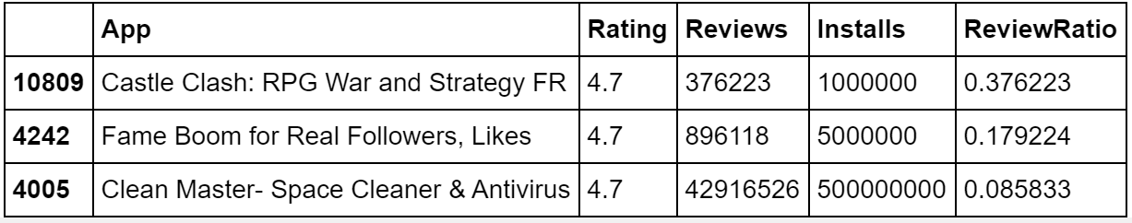
Highest Rated Apps
Notes:
Moving from research question to some kind of hypothesis -- you want to use logic, theory and prior empirical evidence to move toward some hypotheses you can test. This is why domain expertise cannot be overlooked among data scientists.

Slide 7
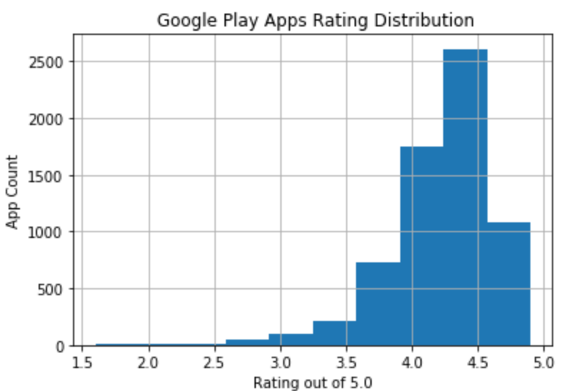
Apps vary by rating:
Over 2,500 of the apps in the top 10 bins have a rating of over 4.2 to a nudge over 4.5, maybe 4.6.
And almost 1000 apps have been rated higher than that.
Most reviewed apps, have ratings of 4.7
Further analysis, we have 129 apps with ratings higher than 4.7
Notes:
A statistical method is not a story, but we can tell a story from the statistics. For example, using confidence intervals we can put into dollars what we think would happen if we make some business move, given the data that we have.
The words “t-test,” “normality,” “independent samples” etc did not come up at all in this explanation! Although someone who does know about this stuff can still have confidence in the results with the way you have laid out the story and the quantifiable results.

Slide 8
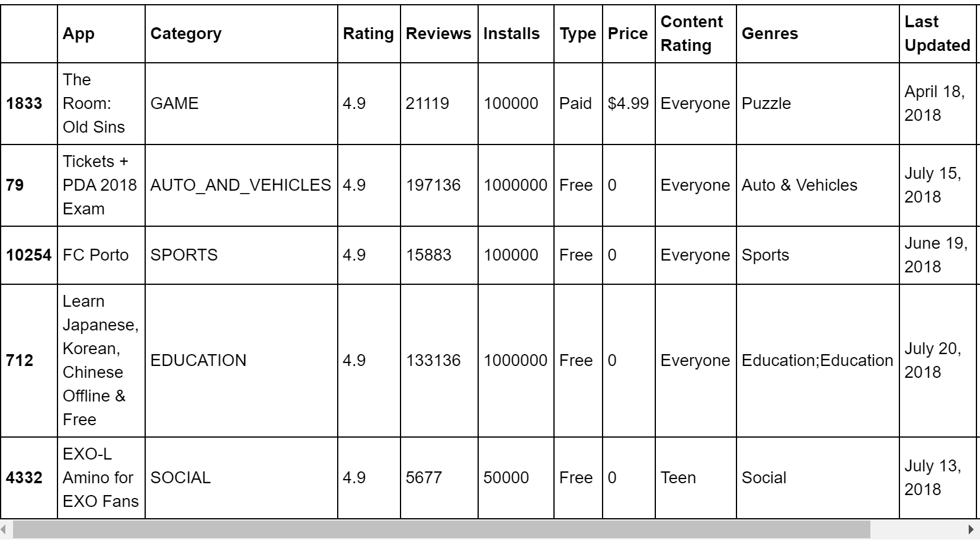
Top 5 apps by rating:
Notes:
A statistical method is not a story, but we can tell a story from the statistics. For example, using confidence intervals we can put into dollars what we think would happen if we make some business move, given the data that we have.
The words “t-test,” “normality,” “independent samples” etc did not come up at all in this explanation! Although someone who does know about this stuff can still have confidence in the results with the way you have laid out the story and the quantifiable results.

Slide 9
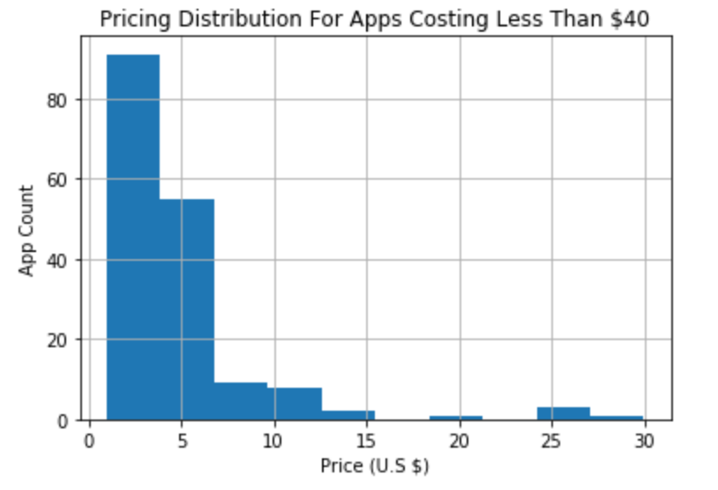
Apps vary by pricing:
Most apps cost less than $5 or even $3.
Amount of apps that cost more than that significantly decrease as we go up through the pricing.
Human creativity, ability to code will lower the entry barriers for more competition.
Pricing an app significantly higher than the market will certainly require significant, sustainable competitive advantage.
Notes:
A statistical method is not a story, but we can tell a story from the statistics. For example, using confidence intervals we can put into dollars what we think would happen if we make some business move, given the data that we have.
The words “t-test,” “normality,” “independent samples” etc did not come up at all in this explanation! Although someone who does know about this stuff can still have confidence in the results with the way you have laid out the story and the quantifiable results.

Slide 10
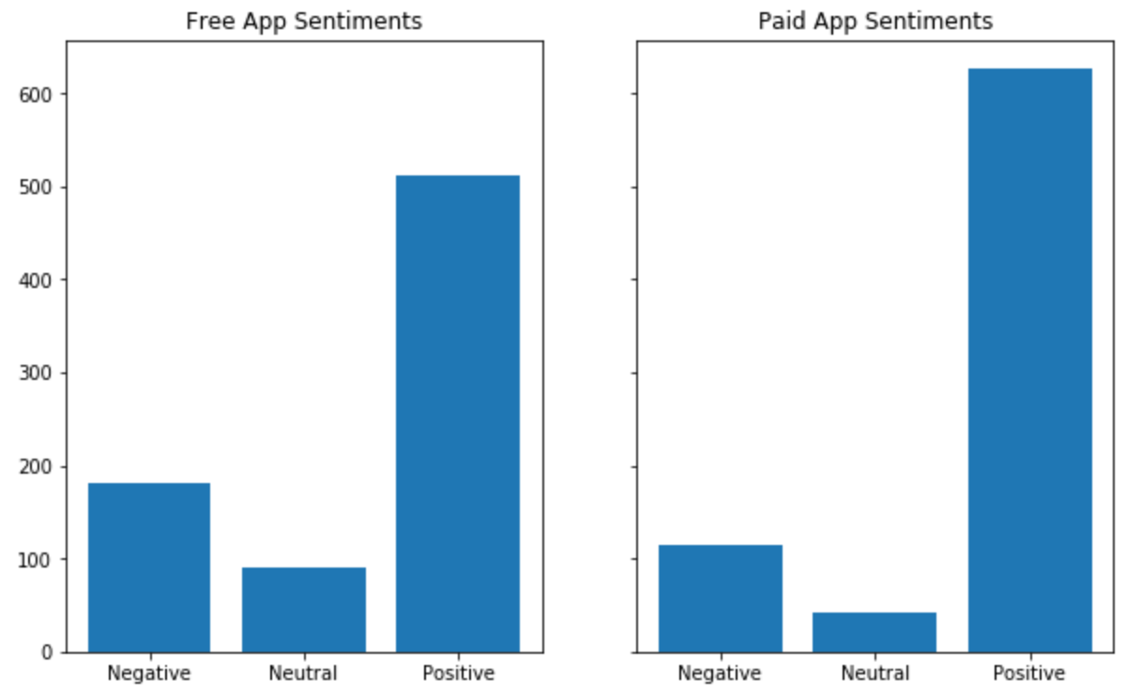
People reviews – Free Vs. Paid Apps
After we have taken a sample free apps of equal size to paid apps, the plots shows difference in positive sentiments is distributed.
Free apps have more negative and neutral reviews, indicating higher variance of sentiments for free apps.
Notes:
A statistical method is not a story, but we can tell a story from the statistics. For example, using confidence intervals we can put into dollars what we think would happen if we make some business move, given the data that we have.
The words “t-test,” “normality,” “independent samples” etc did not come up at all in this explanation! Although someone who does know about this stuff can still have confidence in the results with the way you have laid out the story and the quantifiable results.

Slide 11
Conclusion
For a broader analysis, the dataset could've contained some of key information like user behaviors, and their browsing / buying habits , fav. contents etc.,
Sample could have from various geographical locations and this would have helped us to understand what's popular where and why.
Notes:
https://unsplash.com/photos/OX_en7CXMj4
Then we want to move to recommendations, what is the call to action? What should your audience do now that they know what you have told them?

Slide 12
Questions?

Slide 13
Thank You

